Slide 1



VISVESVARAYA TECHNOLOGY UNIVERSITY-BELAGAVI
PRSENTATION ON​
Topic :Smart Pothole Detection and Clearance System for Pothole-Free Roads
Presented By​​​
H. SAFIA NAAZ | 3PG21CS015
SANJANA B SAWANT | 3PG21CS049
HASEENA BEGUM | 3PG22CS400
HEENA KOUSER | 3PG22CS401
DEPARTMENT OF COMPUTER SCIENCE AND ENGINEERING ​​​
Under the Guidance
Of
Prof. Indira _{MTech, (PhD)}
Ballari V.V.Sangha’s​
​​T.B.DAM ROAD,HOSAPETE-583225 ​
PROUDHADEVARAYA INSTITUTE OF TECHNOLOGY​​​
(Affiliated to VTU, Belagavi, Karnataka & Recognized by AICTE, NewDelhi)​​

Slide 2

Smart Pothole Detection and Clearance System for Pothole-Free Roads
Imagine a future where roads are free from potholes, a reality we can achieve with intelligent technology.

Slide 3
Contents
1.INTRODUCTION
2.PROBLEM STATEMENT
3.LITERATURE SURVEY
4.OBJECTIVES
5.SOFTWARE AND HARDWARE REQUIREMENTS
6.EXISTING SYSTEM LIMITATIONS
7.PROPOSED SYSTEM
8.BLOCK DIAGRAM
9. METHODOLOGY DESIGN AND IMPLEMENTATION
10.WORKING
11.ADVANTAGES
12.APPLICATIONS AND FUTURE SCOPE
13.CONCLUSION

Slide 4
Introduction: The Importance of Pothole-Free Roads
Infrastructure Integrity
Efficient Transportation
Potholes disrupt traffic flow, causing delays and accidents.
They damage vehicles and roads, leading to costly repairs.
Over the last two decades, India has grown tremendously, there has been a rapid increase in the vehicle population, thereby potholes on roads has increased due to increase in vehicles. People and vehicles are affected by the problem.
Potholes, formed due to heavy rains and movement of heavy vehicles, also become a major reason for traumatic accidents and loss of human lives

Slide 5
Problem Statement
The main problem is that potholes will lead to many road accidents thereby just detecting potholes will not help solving the problem completely hence it is necessary to fill them to avoid road accidents.
The problem is worth solving as it helps saving people’s lives and prevents road accidents, thereby helps in growth of the nation having pothole free roads.
​

Slide 6

Literature Survey: Existing Solutions
1
Manual Inspection
2
Automated Detection Systems
Labor-intensive and prone to error.
Using sensors and computer vision to identify potholes.
3
Repair Mechanisms
Ranging from manual patching to robotic repair solutions.

Slide 7
Project name | Author(s) | Year | Advantages | Disadvantages
Pit free :pothole detection indian roads Using moblie sensors | Gaurav Singal, Anurag, Goswami, suneet Gupta, Tejalal Choudhary | 2018 | Utilizes machine learning for detecting and patching potholes. | but struggles with GPS inaccuracy and SVM’s inefficiency for large datasets,since it is not suitable for large datasets.
Path hole Detection System: Using Wireless Sensor Network. | Ashish Gaikwad, Yashwant Belhekar, Mandar Dangre, Ankit Chaudhary | 2020 | Pothole detection system is designed which assists the driver in avoiding potholes on the roads, by giving prior warnings. | The system only provides information of warning drivers about the potholes, but it does not help in filling these potholes.
Identifying and Reporting of Potholes and Humps using | Smita Saitwadekar, Dr. Payelsaha | 2019 | This system gives information about depth of potholes, height of humps as well as location, which is sensed by sensors and stored in database. | Using GPS leads to inaccuracy, lack of local knowledge, driving distraction, privacy issues.
Road Conditions Detection Using Arduino Based Sensing Module | Smartphone Syuan-Yi Chen, Annie Shih and Chun-Hsian | 2021 | 1) The vehicle can obtain nearby road conditions information easily. 2)Traffic management. | Sensing module should be mounted externally.

Slide 8



Objectives: A Comprehensive System
Automatic Detection
1
Real-time identification of potholes using sensor networks.
Reporting and Notification
2
Instant alerts to relevant authorities for timely intervention.
Automated Repair
3
Efficient repair using robotic systems for quick and effective solutions.

Slide 9


Software and hardware Requirements: The Backbone of the System
Sensor Integration and Hardware Description
Integrating sensors(Ultra sonic sensors)for road condition monitoring.
ESP8266 Wi-Fi module
H Bridge L293D,DC MOTOR and a BATTERY
Software Description​
Arduino IDE​
Embedded language

Slide 10

Existing System Limitations: Challenges of the Traditional Approach
Manual Identification
Reporting Delays
Time-consuming, prone to error, and reactive.
Potholes remain unaddressed, leading to further deterioration.
Inefficient Repair
Manual methods are slow and disruptive to traffic.

Slide 11

Proposed System: A Blend of Technologies
1
Internet of Things (IoT)
Sensors for real-time data collection.
2
Computer Vision
Live streaming with(ESP32CAM) for pothole detection.
3
Robotic Technologies
Autonomous repair mechanisms for swift resolutions.

Slide 12
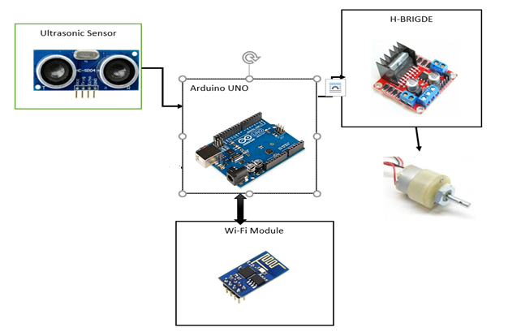
BLOCK DIAGRAM

Slide 13
To implement this project we are using Ultrasonic Sensor .We need two Ultrasonic Sensor one for pothole detection and another one for hump detection .
Block diagram of the project is giving the brief idea about the components used and how the components are connected so that it will help us to detect the potholes on the road.
It, shows all the hardware connection needed for the whole circuit to work.
Such as it contains all the components needed such as Arduino Uno, two Ultrasonic Sensors, a DC motor mechanism to level the pothole and the vehicle, and the ,most important is Power Supply to make all the hardware work.

Slide 14




Methodology Design and Implementation: A Multi-faceted Approach
Sensor Networks
Deployment of sensors to monitor road conditions.
Image Recognition
Processing images from cameras to identify potholes.
Automated Repair Mechanisms
Using robotic systems for efficient pothole repair.

Slide 15
WORKING
The sensors will get activated only when the robot / Vehicle is started as is in motion. After that it will detect the potholes and if the pothole is large it will update and clear the potholes by turning on the leveler motor. For Potholes Detection Using Ultrasonic Sensor 1.
After the activation of Ultrasonic Sensors the 'Trig' pin of the Ultrasonic Sensor will transmit the signal and 'echo' pin will receive the signal. 2.
If it takes longer time for the signal to be received by the 'echo' pin of the Ultrasonic Sensor then there is pothole i.e. if the distance is greater than threshold distance.

Slide 16
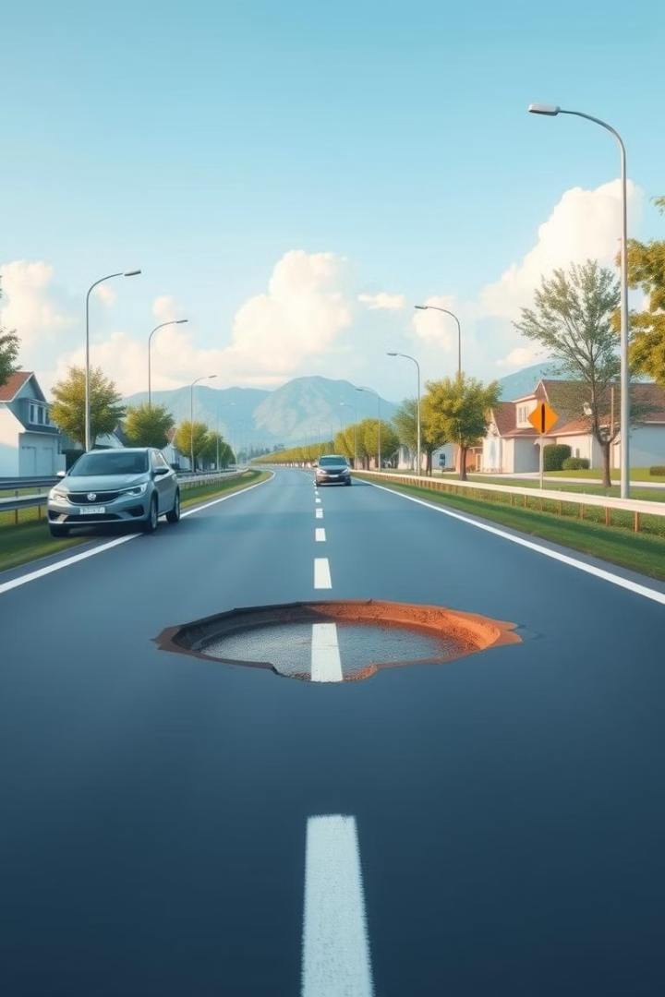
Advantages: A Paradigm Shift in Road Management
1
Improved Road Safety
Reduced accidents and enhanced driver comfort.
2
Reduced Maintenance Costs
Proactive maintenance and fewer costly repairs.
3
Enhanced User Experience
Safer and more efficient driving conditions.

Slide 17

Applications and Future Scope: A Vision for Smart Cities
The system can be integrated with smart city initiatives for a holistic approach to urban infrastructure management.

Slide 18
CONCLUSION
The Smart Pothole Detection and Clearance System integrates IoT, AI, and sensor technologies to identify and address road infrastructure issues efficiently. This system significantly reduces accidents, enhances road safety, and minimizes maintenance costs by automating detection and repair processes. Its real-time data capabilities ensure better decision-making for authorities and promote smoother transportation experiences.

Slide 19

THANK YOU

